Slide 1
Evaluating Procedural devices in an Equilibrating Civil Litigation System
By Michael Abramowicz

Slide 2
Past Papers
Early attempts at computational modeling
Two-sided independent signals paper (published)
Two-sided correlated signals (under review)

Slide 3
Core Advances
Substantive: Endogenous disputes
Parties know precaution level
But only have signals of precaution power
Methodological: Counterfactual Regret Minimization
Trees of 1,290,752 nodes
Bayesian marginalization reduces each tree to 225,497 nodes
2,269 different settings

Slide 4
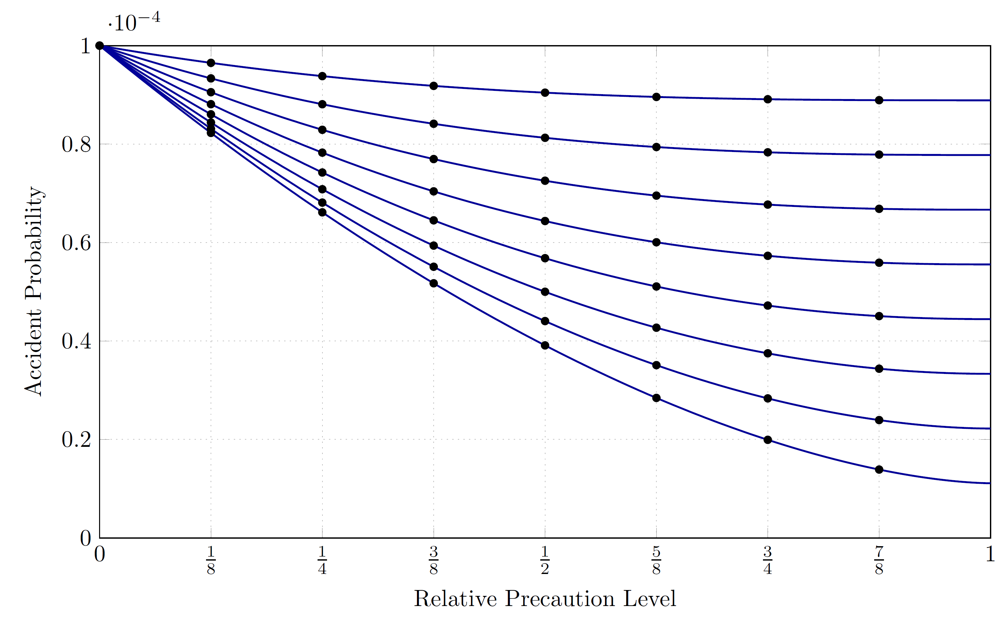
Effect of Precaution Power

Slide 6
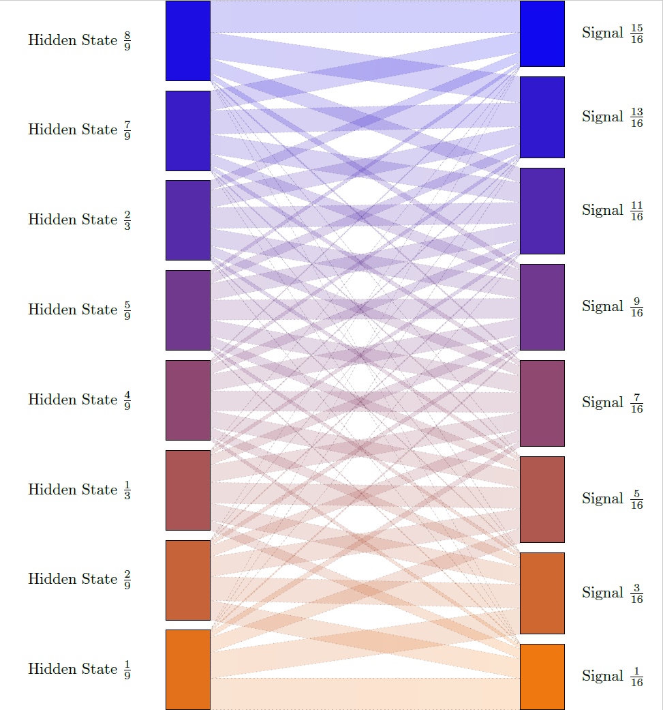

Slide 7
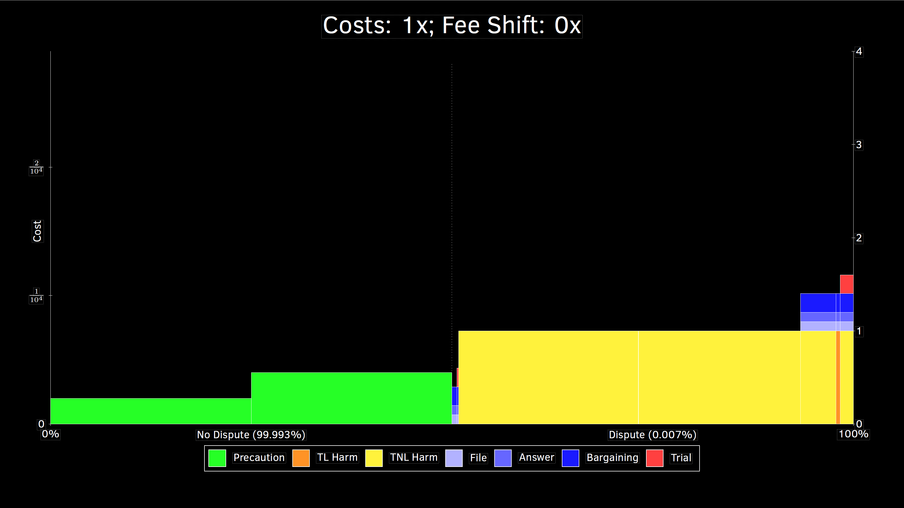

Slide 8
Damages Multipliers (next slides)
0.5x
1x
2x
4x

Slide 9
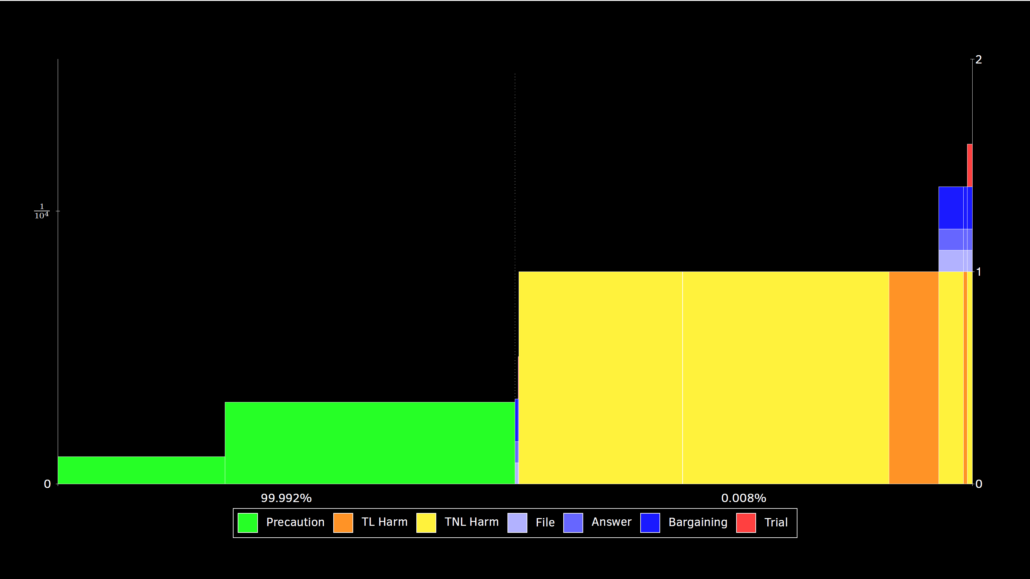
0.5x

Slide 10
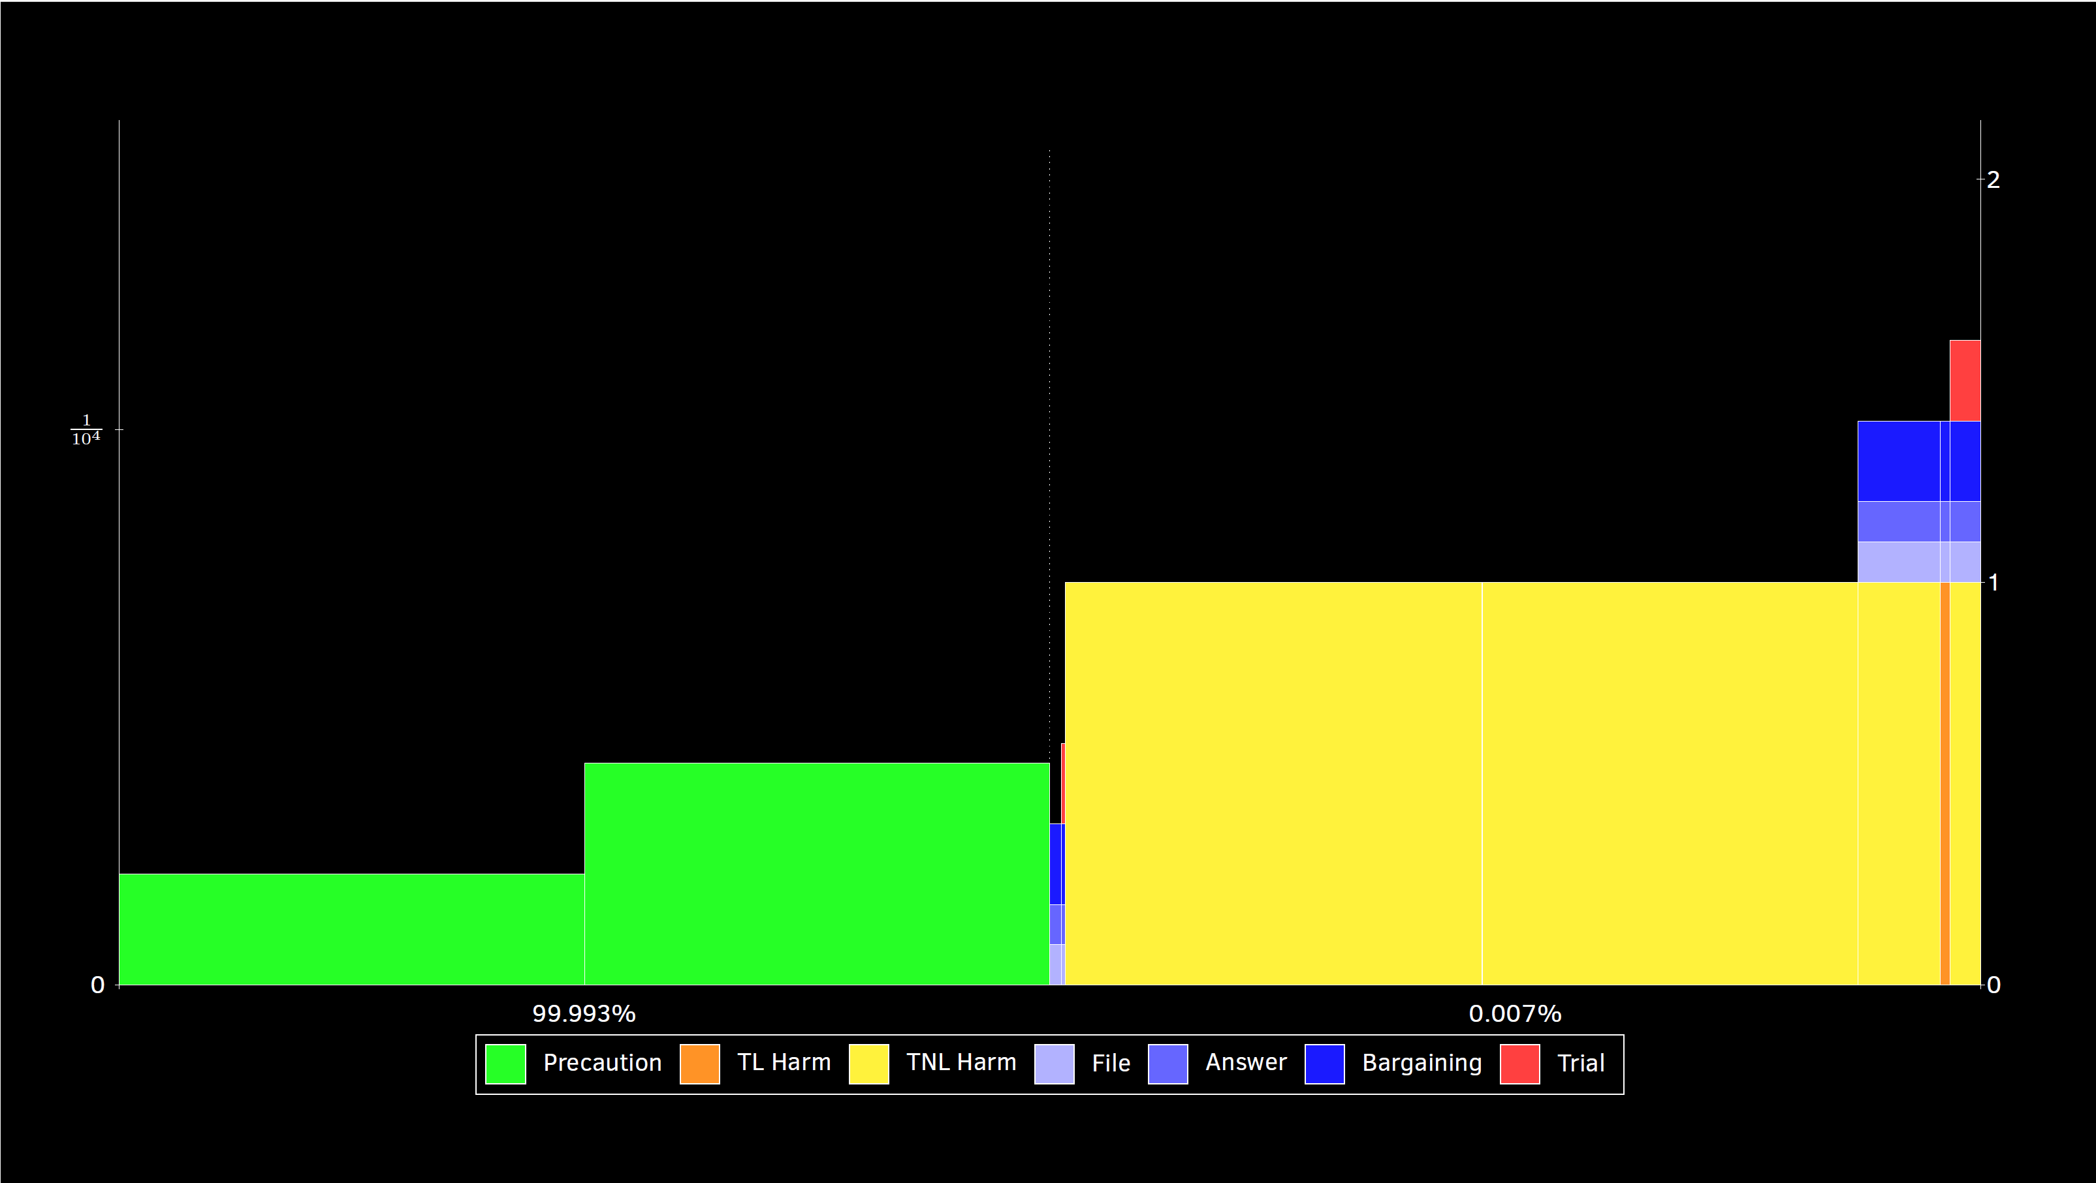
1x

Slide 11
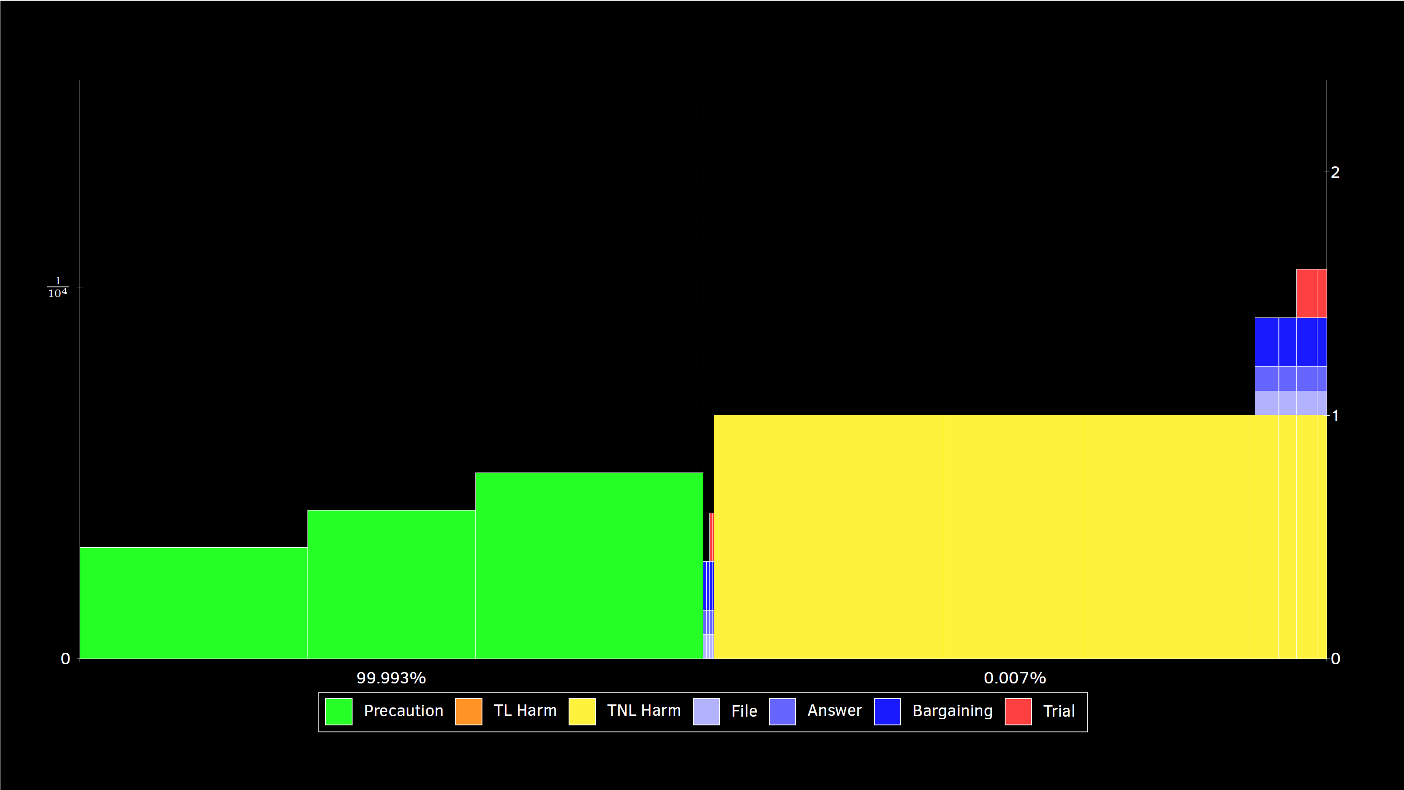
2x

Slide 12
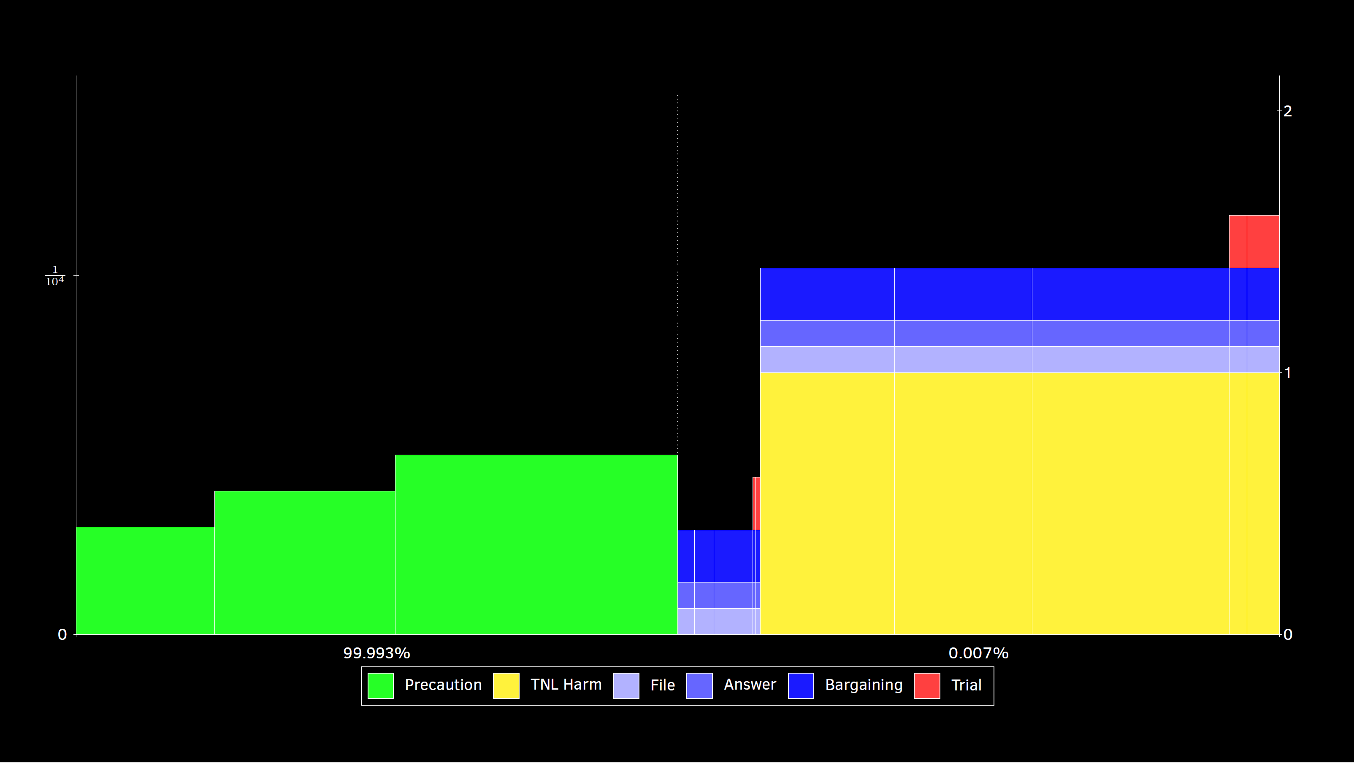
4x

Slide 13
Fee Shifting Multipliers (next slides)
0x (American) 0.5x 1x (British) 2x 5x

Slide 14
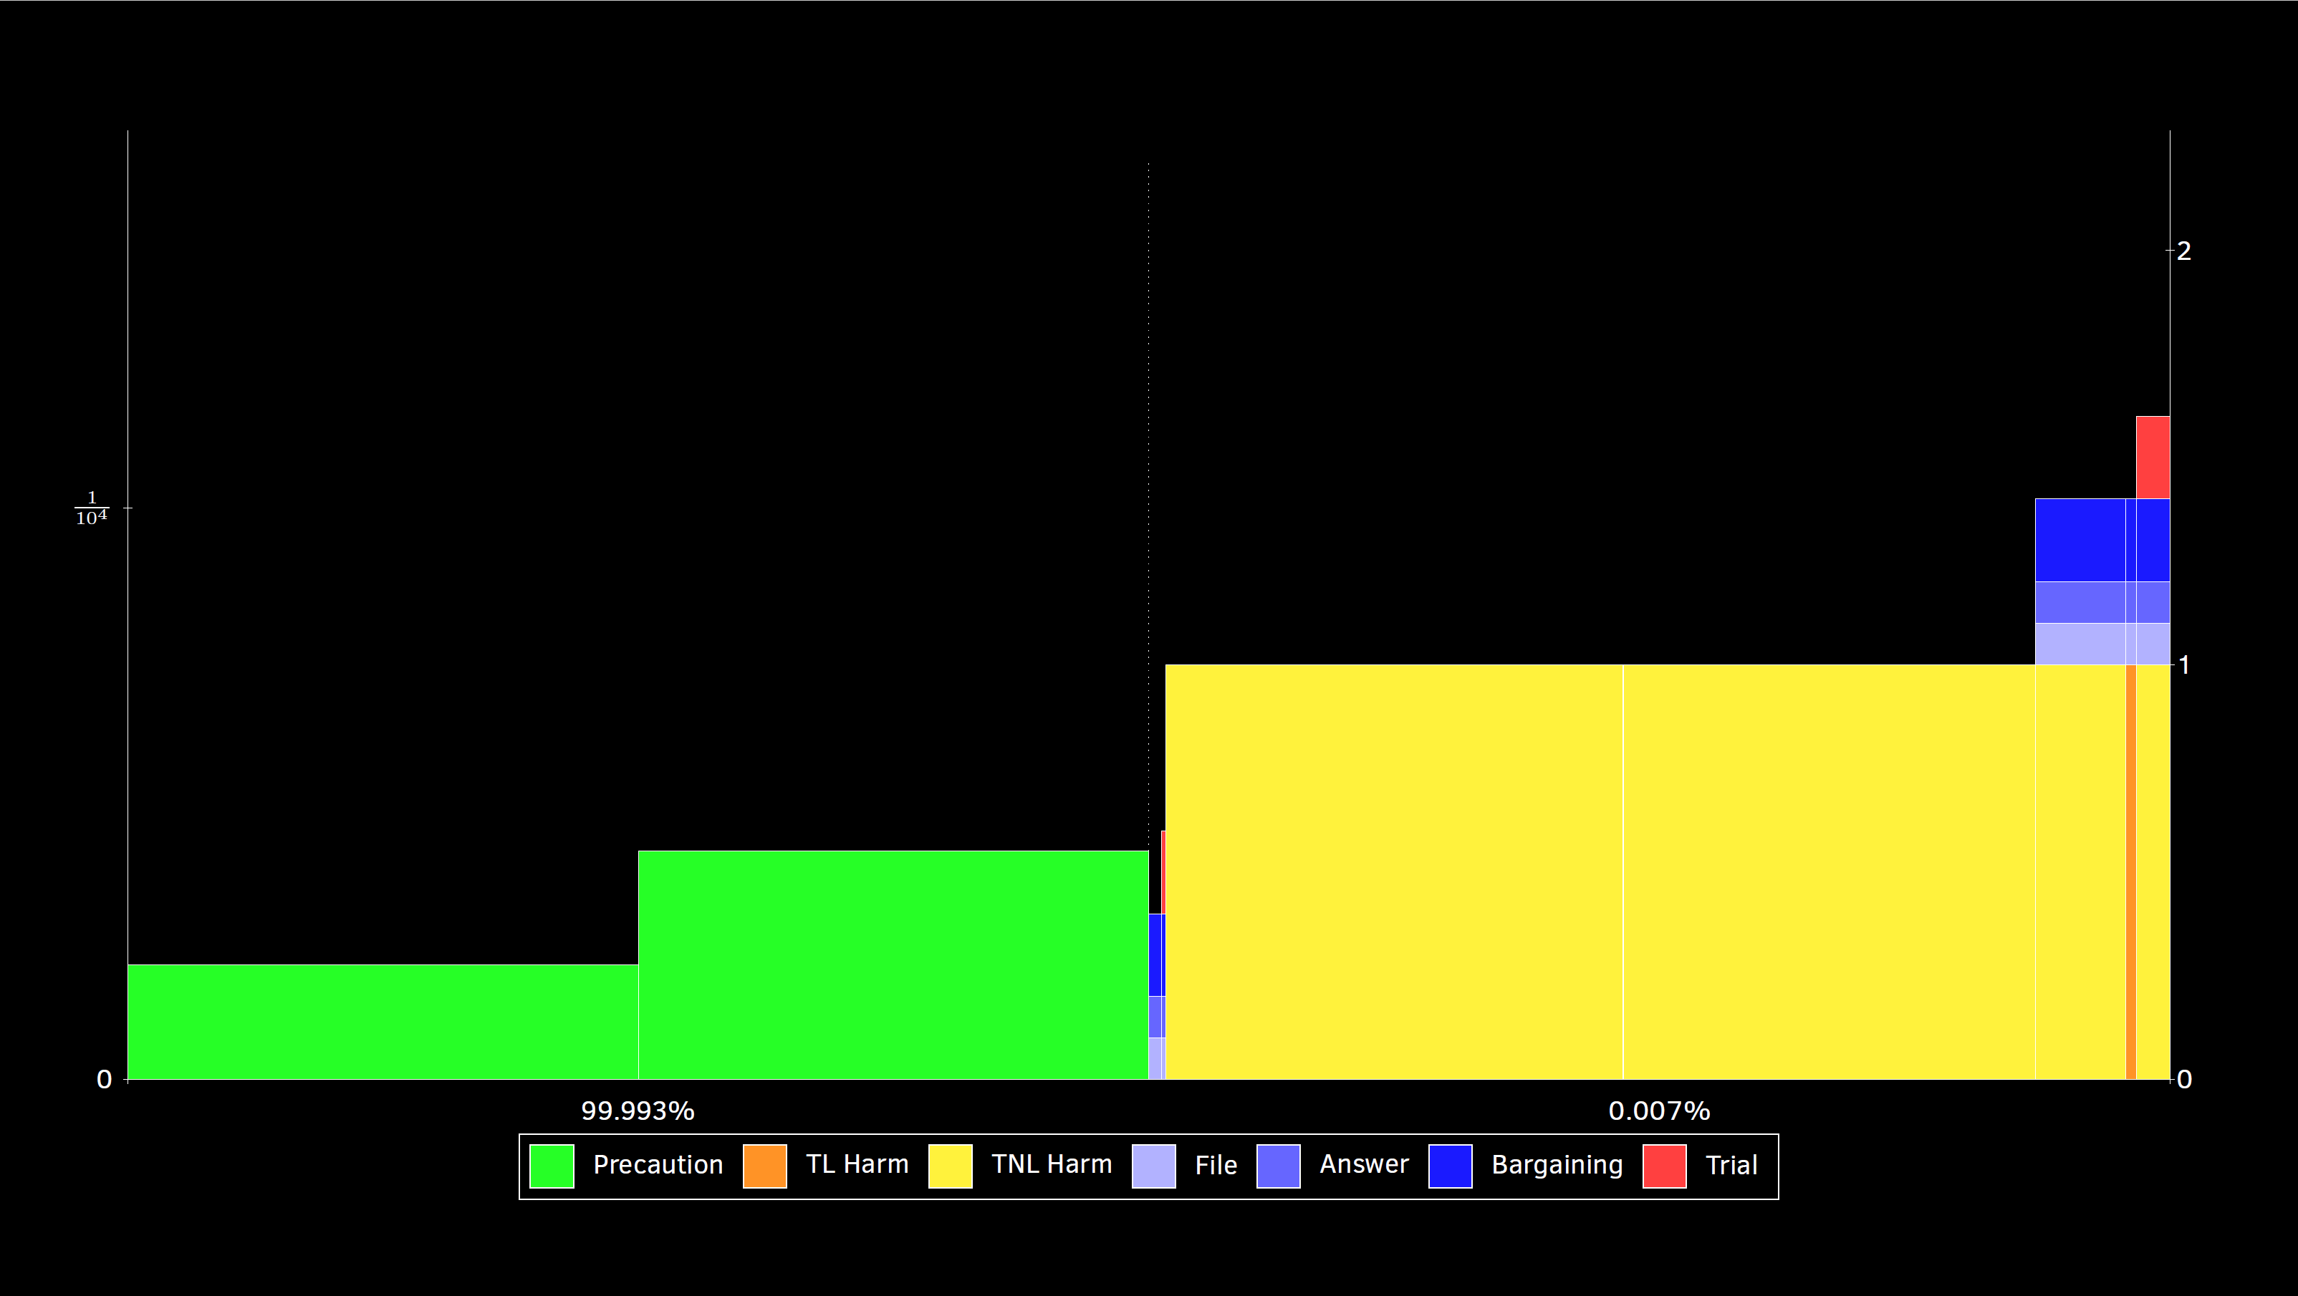
0x (American)

Slide 15
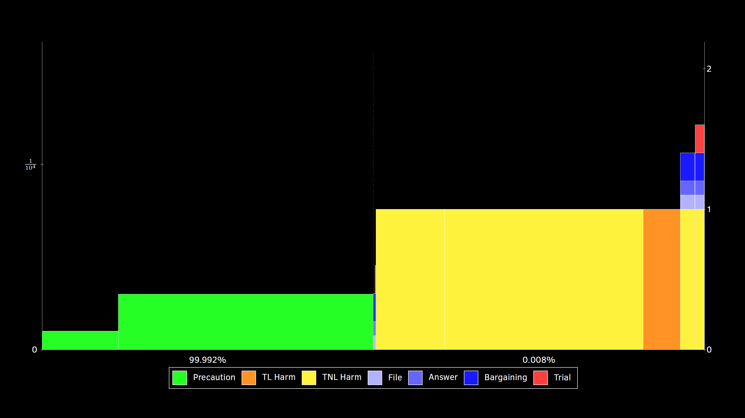
0.5x

Slide 16
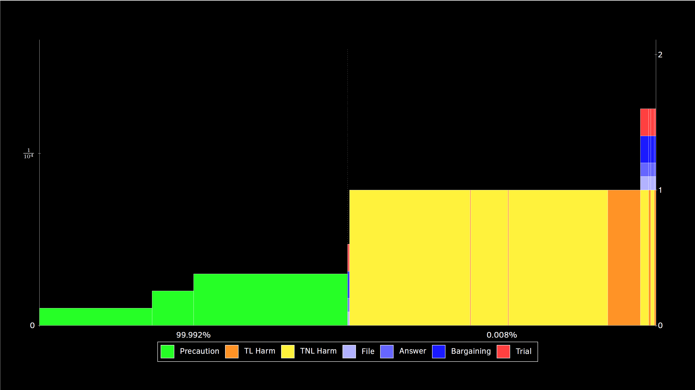
1x (British)

Slide 17
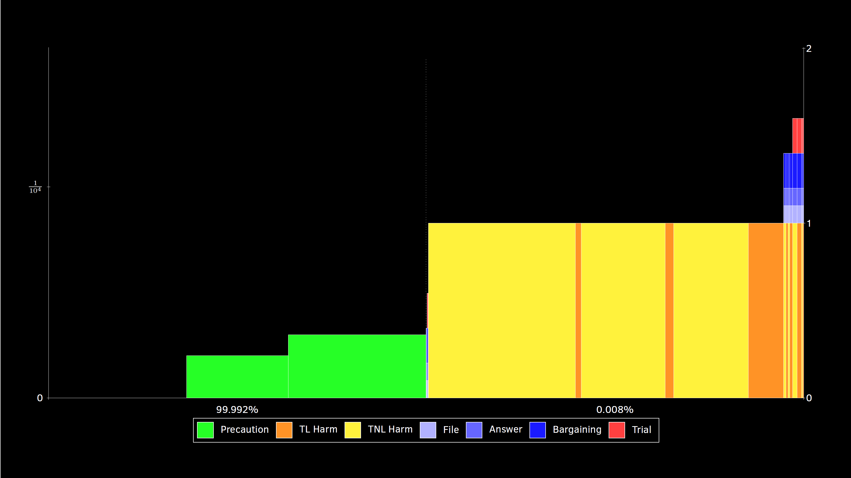
2x

Slide 18
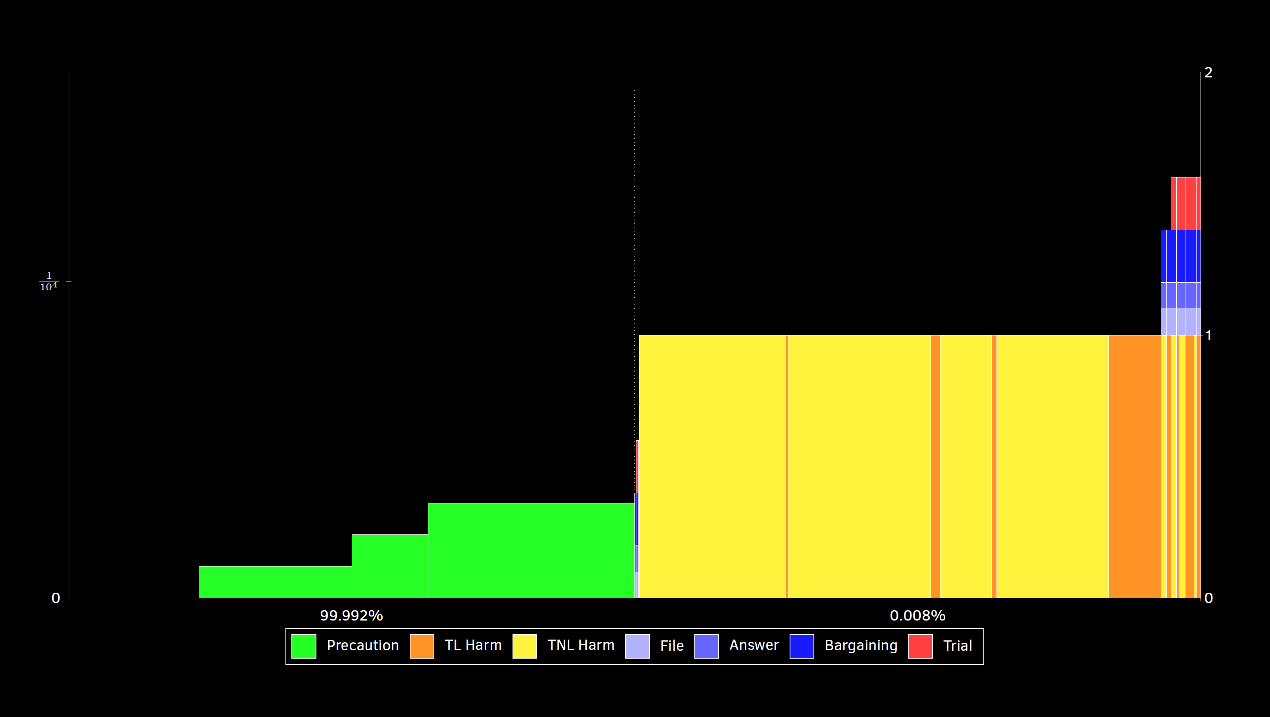
5x

Slide 19
Liability Threshold (next slides)
Strict
Low
Normal
High
Very High

Slide 20
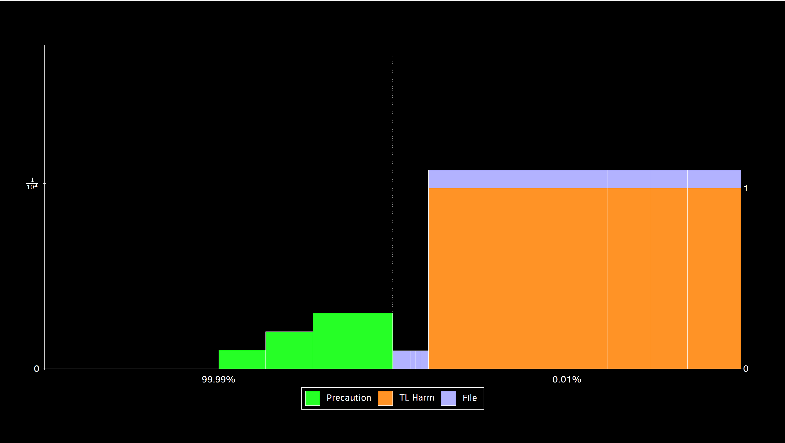
Strict

Slide 21
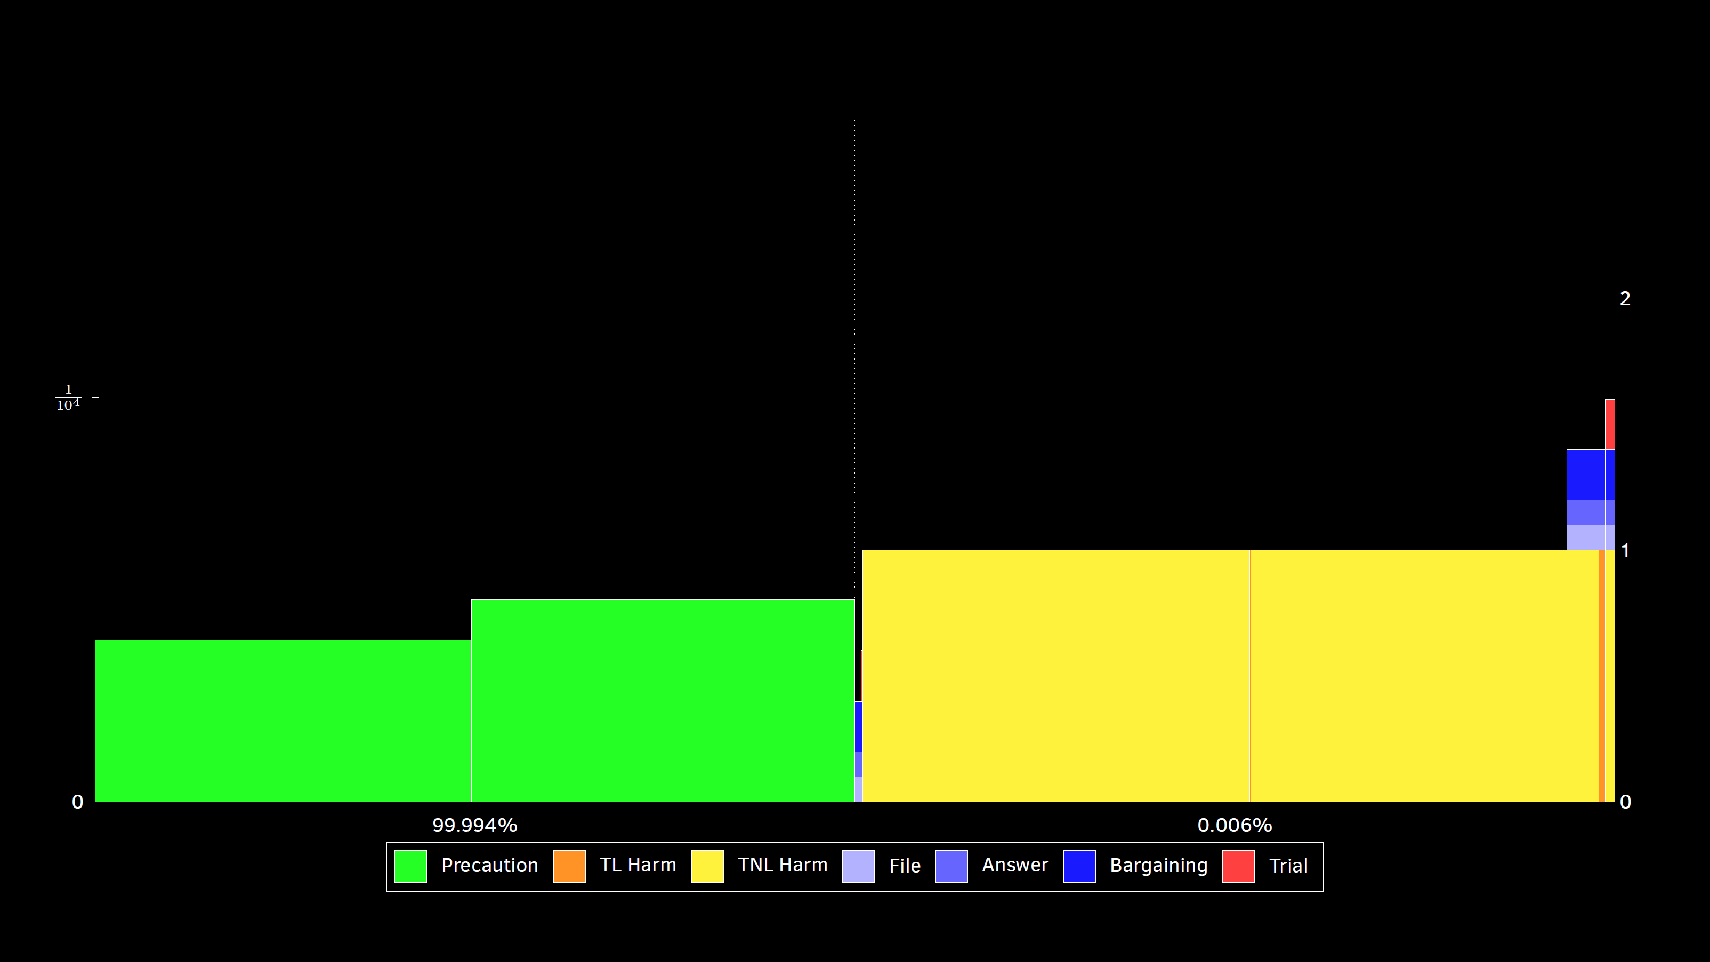
Low

Slide 22
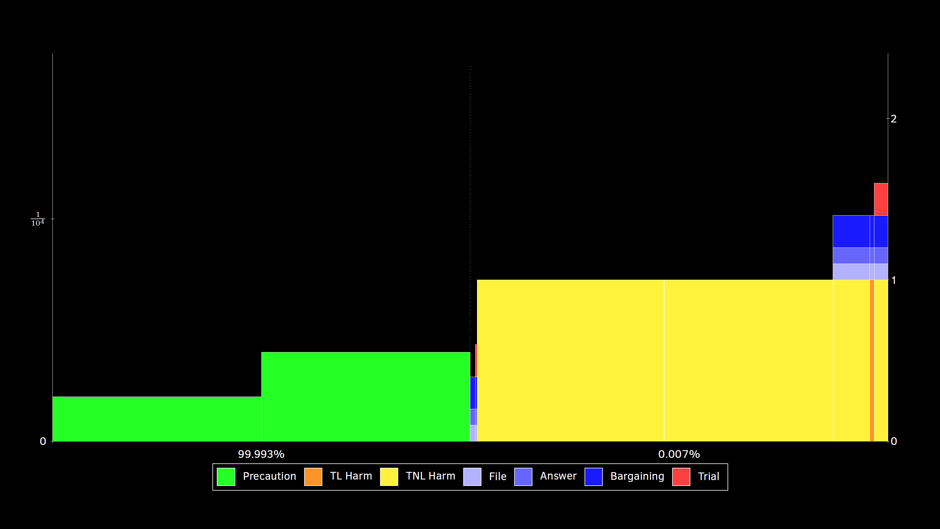
Normal

Slide 23
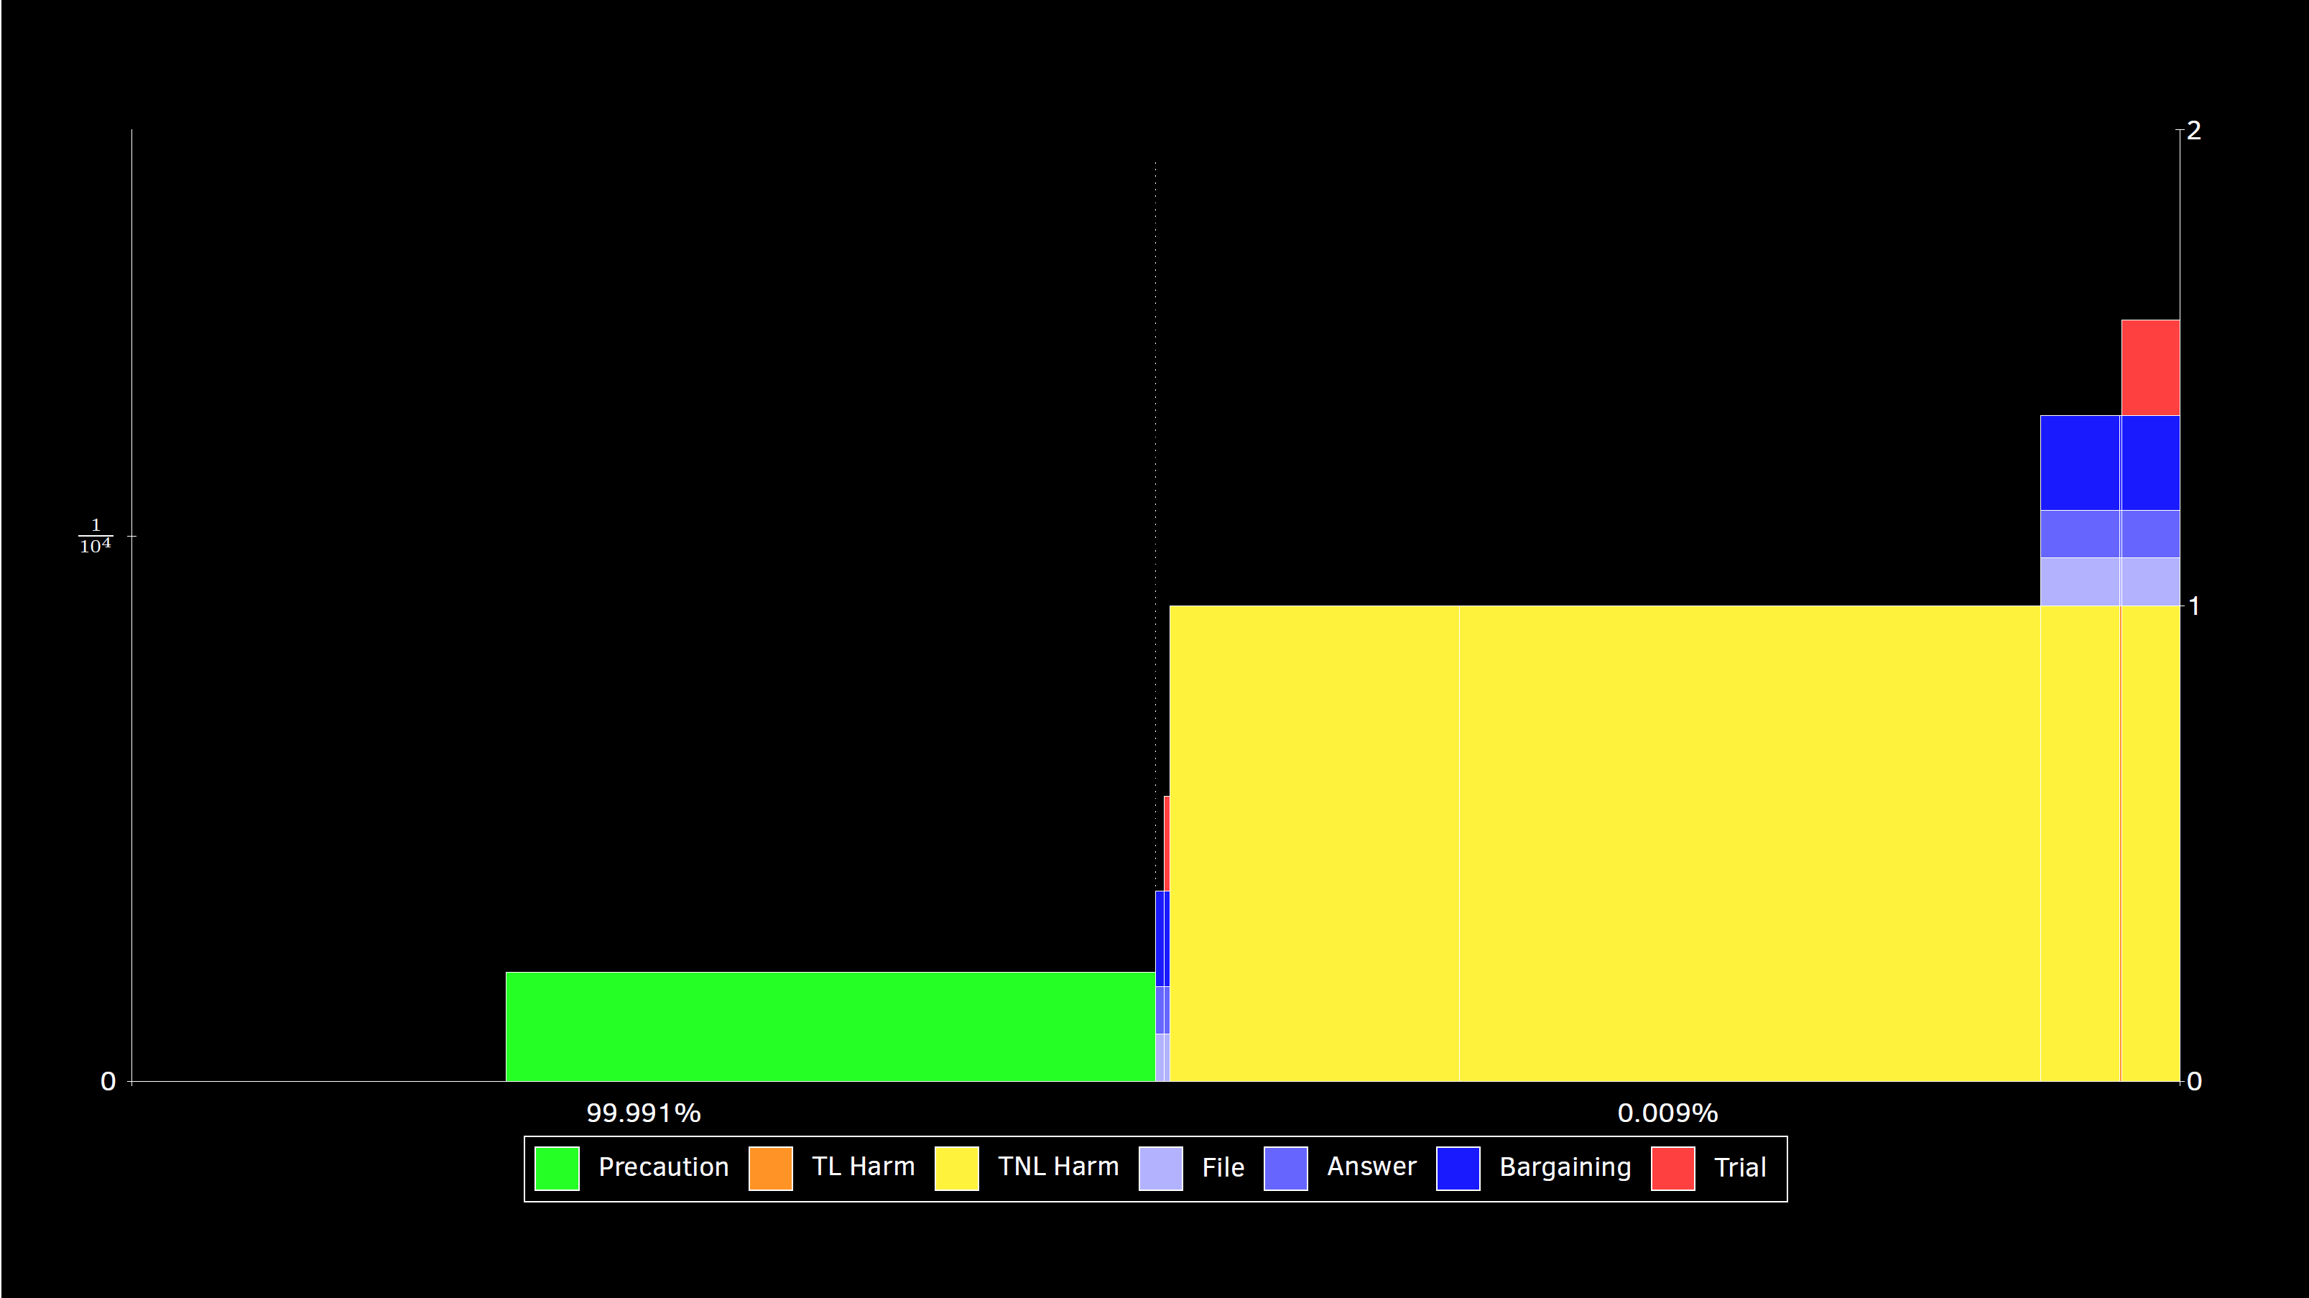
High

Slide 24
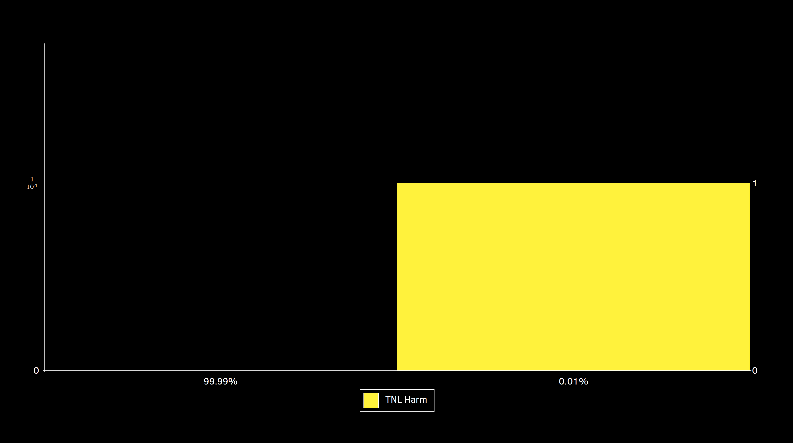
Very High

